Slide 1
Computer Graphics and Image Processing
Graphics Concepts

Slide 2
Outline
Polygon Rendering
Graphics Data Structures
Graphics Pipeline, Fixed vs Programmable
A Simple OpenGL Program

Slide 3
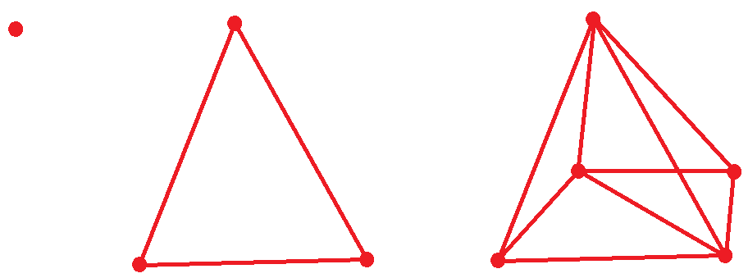
Polygon Rendering
When we render an image, we need ways to define and track what we want to render
Vertex
Primitive/Polygon (Triangle)
Mesh/Model

Slide 4
Polygon Rendering
Rendering with OpenGL has stages on the CPU and the GPU
The GPU renders at the Vertex and Primitive level*
On the CPU, we use higher level constructs like meshes to manage collections of vertices and primitives
*Modern graphics APIs work with some higher level constructs too

Slide 5
Vertex
A single point in space
Defined as a position vector (x, y, z) or (x, y, z, 1)
The properties associated with that point e.g.
Colour
Normal of surface at that point
Other properties as needed by application
Data Structure is Class/Struct storing:
Position vector
Any other properties

Slide 6
Primitives
We deal with 5 main primitive types
Point
Line
Triangle
Quad
Polygon
In practice we mostly deal with Triangles, but some examples in this course will use other types for convenience
Usually rendered as multiple triangles

Slide 7
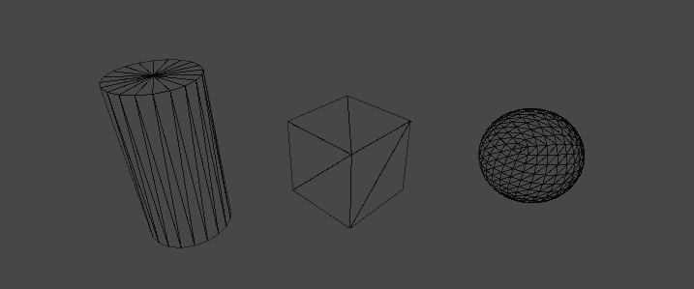
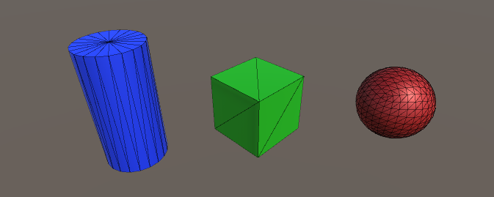
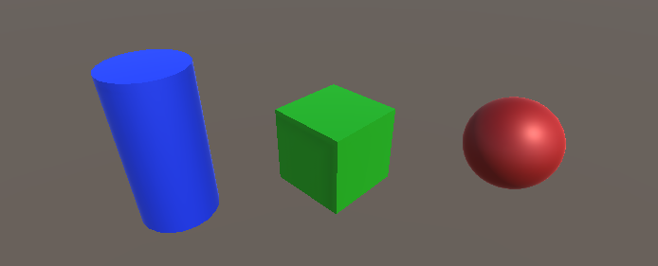
Polygon Rendering
We connect vertices to form
primitives and meshes
The primitives are usually rendered as surfaces
Lighting and Shading causes the surfaces to look more real

Slide 8
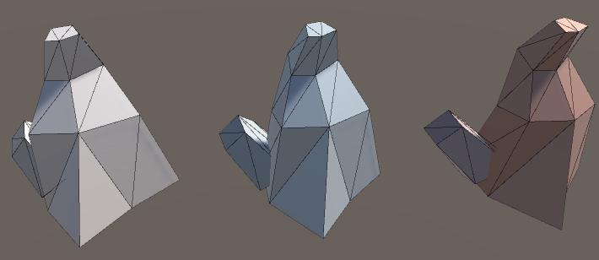
Mesh
A collection of vertices and rules for how they are assembled into primitives
We can define a mesh and draw it many times
Each instance can be drawn differently

Slide 9
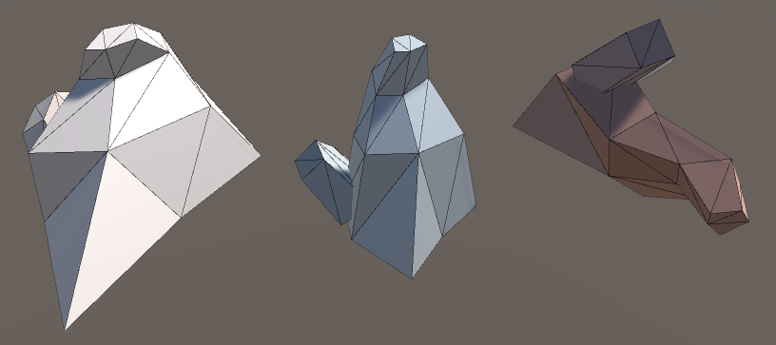
Mesh Transformation
To transform a mesh, we multiply the position of every vertex by a transformation matrix
Every mesh instance can have its own transformation

Slide 10
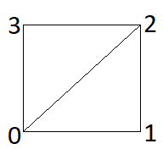
Mesh Data Structure
Vertices
Array of Vertex data structure
List of all of the vertices used by the mesh
[v0, v1, v2, v3]
Indices
Array of integers
Lists how vertices are assembled into primitives
[0, 1, 2, 0, 2, 3]
Two triangles, using vertices at indices 0, 1, and 2, and vertices at indices 0, 2, and 3
Vertices 0 & 2 are used by two triangles

Slide 11
A Simple Mesh Drawing Algorithm
algorithm draw-mesh
input: array of vertices v
array of indices n
Set primitive type
for each index i in n do
send v[i] to GPU
In Fixed-Function OpenGL, we write this code
In modern OpenGL, this is automatically handled GPU-side
We pass buffers of vertices and indices to the GPU

Slide 12
Scene
The highest level construct we typically deal with is the concept of a Scene
All of the objects (meshes) to be rendered
The transformation of each instance of those objects
A camera defining a viewpoint from which the rendering takes place
May not be formally defined for simple applications

Slide 13
Scene Hierarchy
Often we want some objects to be dependent on other objects
E.g. People on a boat move with the boat
These objects can then move relative to the parent object
E.g. People move around on top of the boat
Child objects are transformed in the coordinate system of the parent object

Slide 14
Polygon Rendering
Basic Steps:
Define the vertices in our scene and how they are assembled into primitives
Determine which parts of the screen these primitives cover
Fill in the pixels covered by the primitive according to colour/lighting/etc
CPU
GPU

Slide 15
Fixed Function Pipeline
Fixed
Function
Pipeline

Slide 16
Fixed Function Pipeline
Transform each vertex based on view & model transformations
Define vertices
MODELVIEW
Transformation
PROJECTION
Transformation
Clipping
Remove non-visible parts of scene
Project each vertex on 2D view plane and compute depth values
Viewport
Transformation
Rasterization
Display
Compute pixels in frame buffer (use drawing mode, windows information, colour interpolation)
Optional apply textures
Compute vertex positions within viewport (if any)

Slide 17
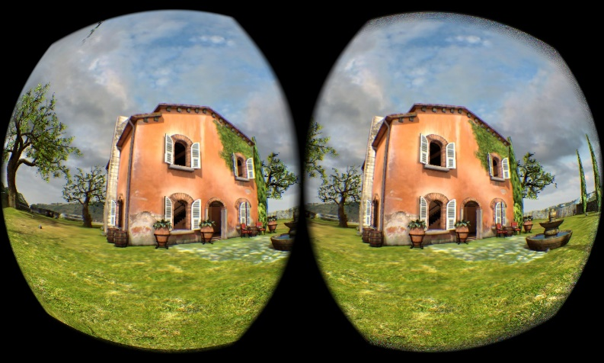


Shaders (GLSL)
In modern graphics, the Fixed-Function pipeline is too limiting
What if we could define what we want to do ourselves?
Shaders are programs that run on the GPU and replace parts of the fixed pipeline
VR Distortion
Toon Shading
Subsurface Scattering

Slide 18
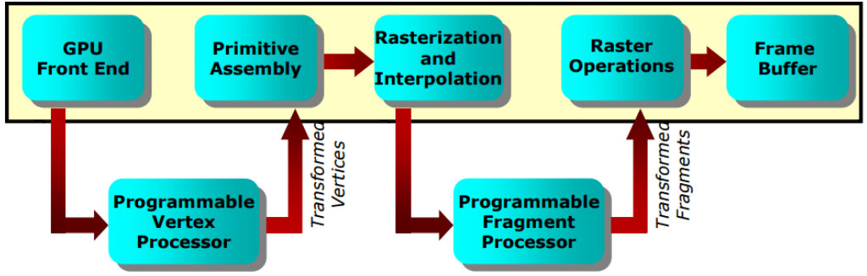
Shaders
A fragment is usually equivalent to a pixel.
Vertex Shader
Fragment Shader
Per-vertex operations
Transformation, projection steps
Per-fragment operations
Lighting, shading, texturing
Vertex Shader
Fragment Shader

Slide 19
Shaders (GLSL)
Shaders | Fixed Function
Faster* | Slower*
General purpose | Limited functionality
Large amount of overhead code | Straightforward
In this course, we use the Fixed-Function Pipeline
Graphics concepts e.g. transformations, texture maps, apply to both approaches
*On modern GPUs

Slide 20
Graphics Program Structure
A typical OpenGL-based program will include the following steps:
Create a Window // open a window into the frame buffer into which the
// program will draw.
// A GL context is associated with the window and all
// subsequent OpenGL commands are with respect to // the current context.
Define view // Specify how scene (2D or 3D) is mapped onto a // window on the screen
Define rendering parameters // For example, lighting
Draw the scene // Set colour or material properties of objects & draw them

Slide 21
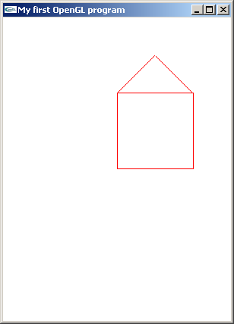
A Simple Graphics Program
We define a simple mesh based on line primitives
We draw in 2D
What do we need
to do this?
y
x
The Situation
The Program Output

Slide 22
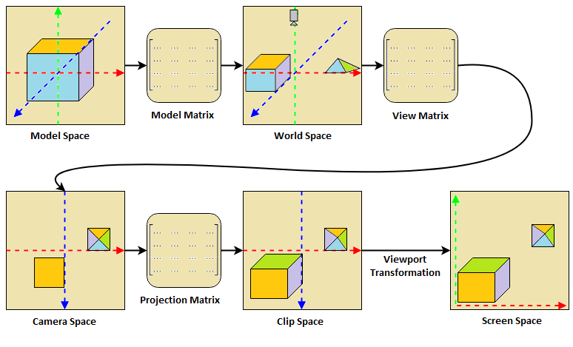
We Need Matrices
Camera looking in –y direction

Slide 23
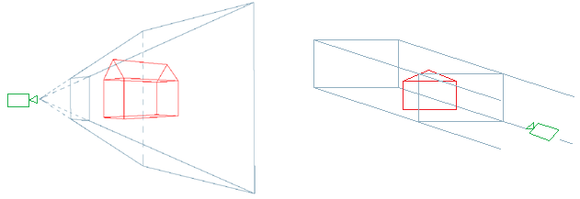
Projection
How do we take our scene coordinates and transform them according to how we want to view them?
Perspective Projection
(3D)
Orthographic Projection (2D)

Slide 24
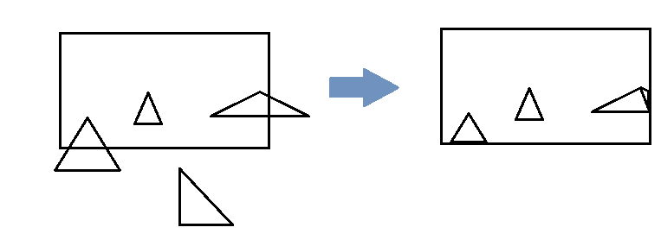
Clipping
In a complex scene, some primitives may end up outside of view
No point trying to render these
After projection, primitives are in clip space
Clip Space defines a space [-1…1] on each axis
Anything outside of this space is discarded
Primitives partially outside of this space are remade as 1+ triangles

